Slide 1



EDA & EVALUATION RESULTS
E-Commerce
Product Categorization

Slide 2
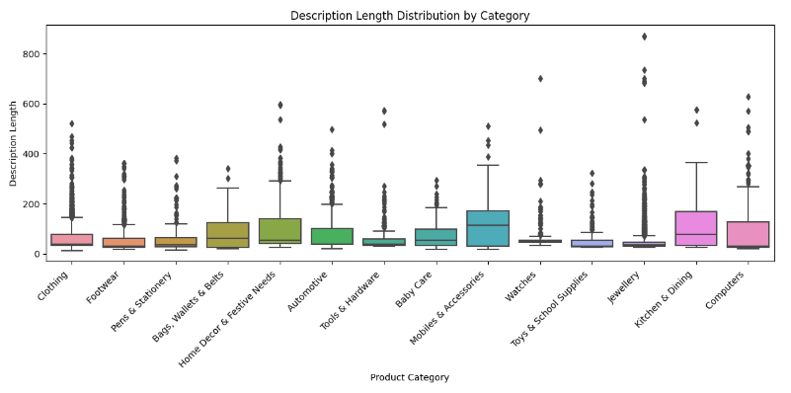

Description Length Distribution by Category
Descriptions for products in the “Mobiles & Accessories” category tend to be the longest, followed by “Kitchens & Dining” and “Computers.”
Descriptions for products in the “Clothing” ,”watches” and “Footwear” categories tend to be on the shorter side.

Slide 3
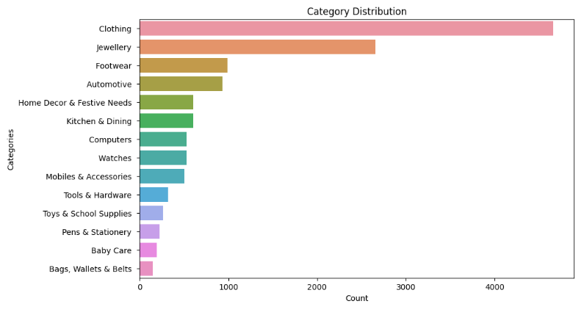
Category Distribution
Dataset contains more categories of “Clothing” followed by “Jewellery” and “Footwear”, this implies that customers are more interested in buying this products probably female customers

Slide 4
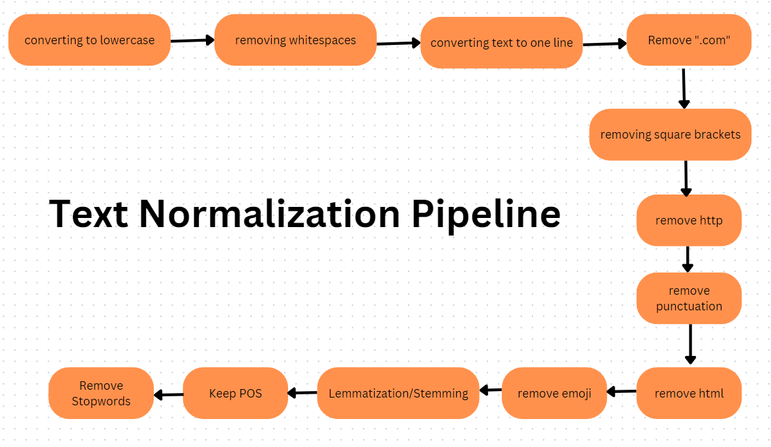
Text Normalization Pipeline

Slide 5
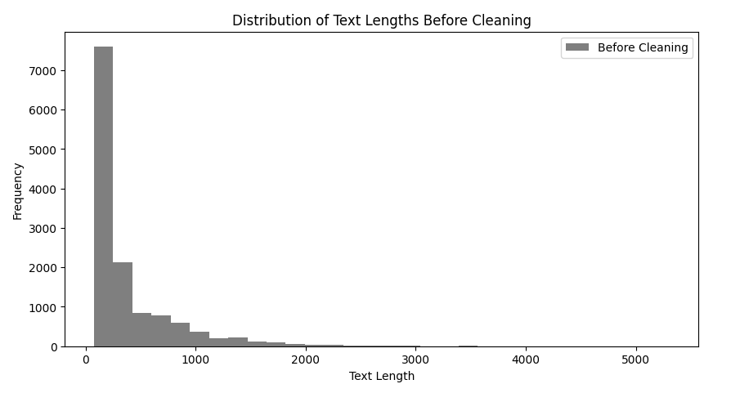
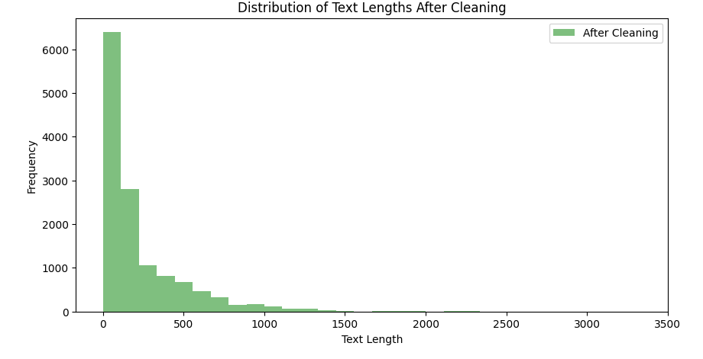
After Applying Normalization
Percentage reduction in text length after cleaning: 44.75%

Slide 6
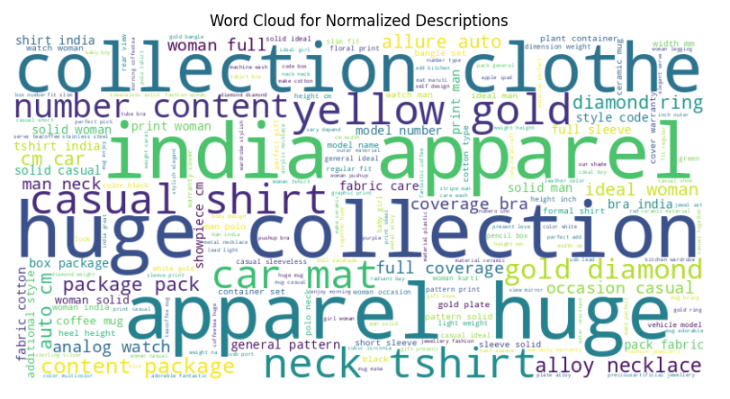
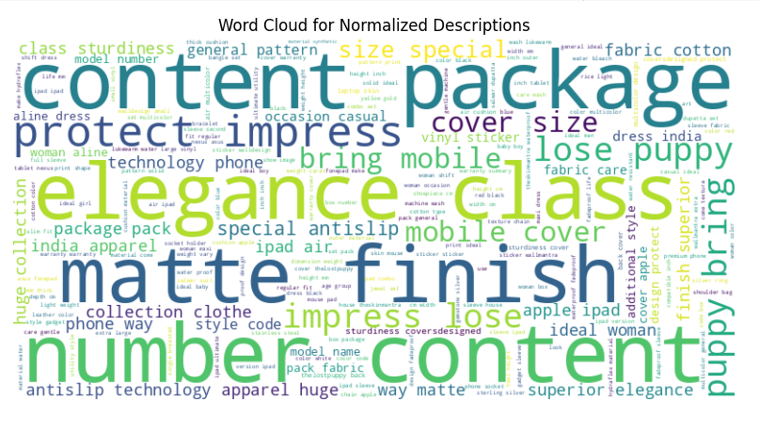
Word Distribution After Normalization
Training Data
Testing Data

Slide 7
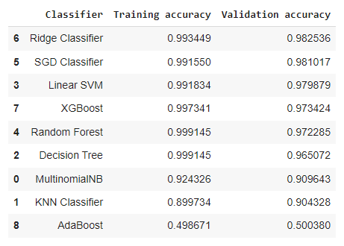
Applying Models on TF-IDF Vectorization
Ridge Classifiers performed best of all

Slide 8
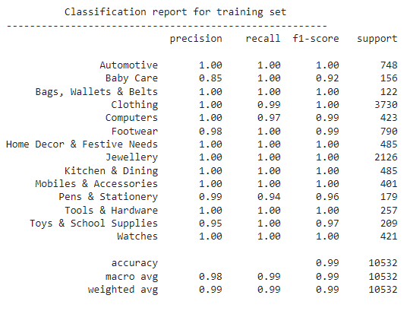
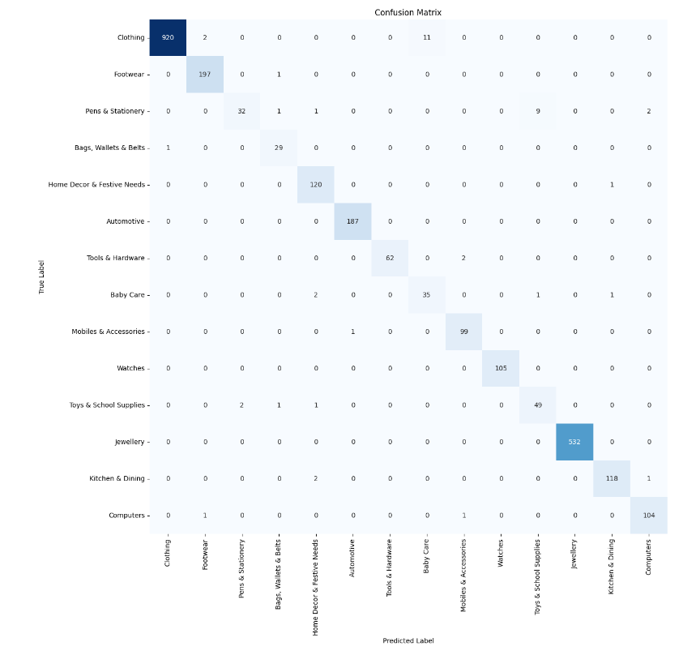
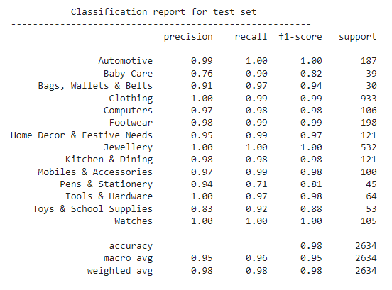
HyperParameter Tuning on Best Perfomed

Slide 9
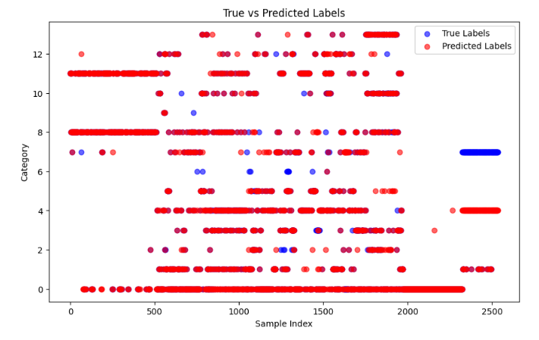
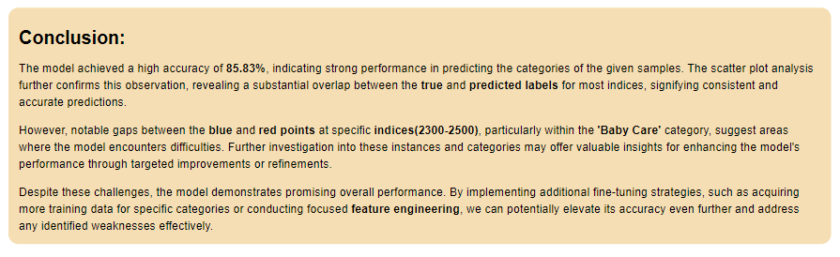
Prediction on Test Data

Slide 10
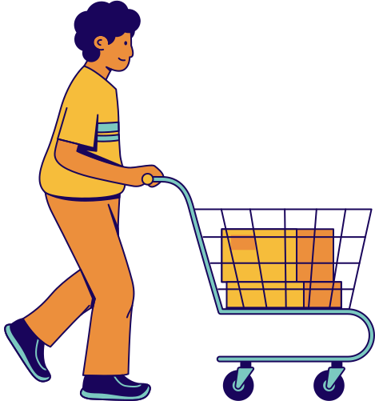
Thank you

